Slide 1
INSIGHT
Inventory®
. . . identifying your unique
personality strengths

Slide 2
Understanding personality differences is key to effective communication!
The INSIGHT Inventory will help you better understand yourself and others!

Slide 3
OBJECTIVES
1) Identify the strengths of your personality style.
Recognize the positives in other people’s personalities.
Learn how to “flex” your style to communicate more effectively with people having different styles.

Slide 4
PROGRAM COMPONENTS
• Identify your profile
• Learn about personality strengths
• Understand stress reactions and triggers
• Identify “flexing” strategies

Slide 5
ABOUT the INSIGHT Inventory
Two profiles: Work and Personal
— behavior may change from one setting to another
Positive
—emphasizes strengths, positive psychology
Research based
—your results are based on normative data and 30+ years of research

Slide 6
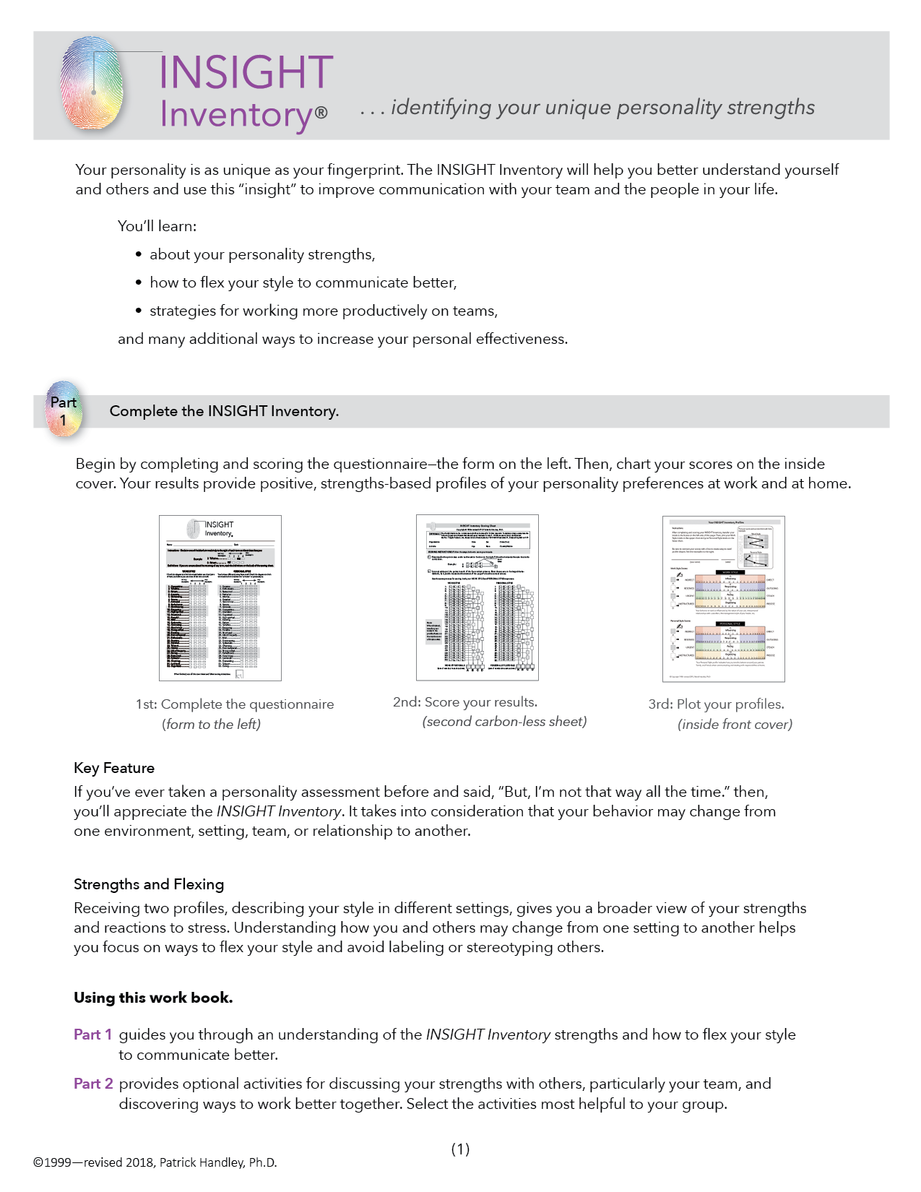
PART
1
Complete the
INSIGHT Inventory

Slide 7
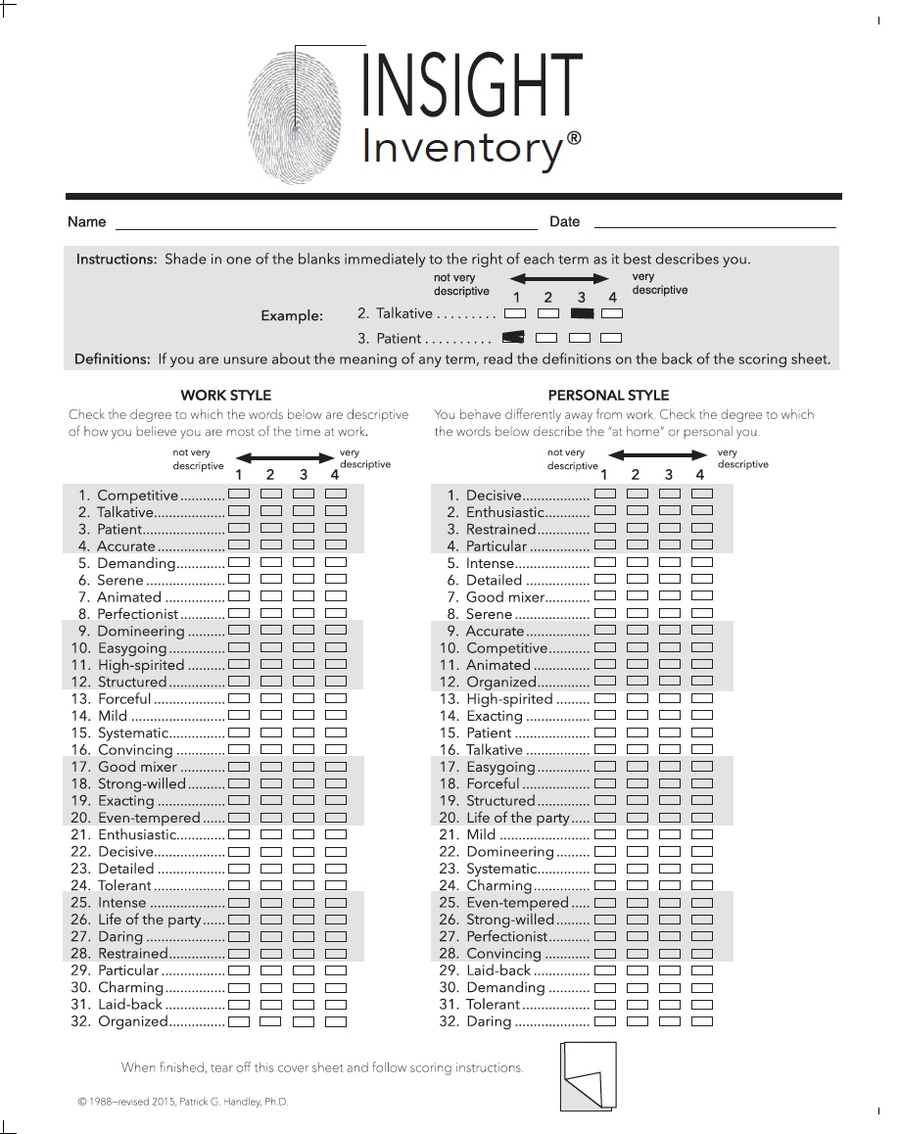
1st
Complete the
INSIGHT Inventory
questionnaire.

Slide 8
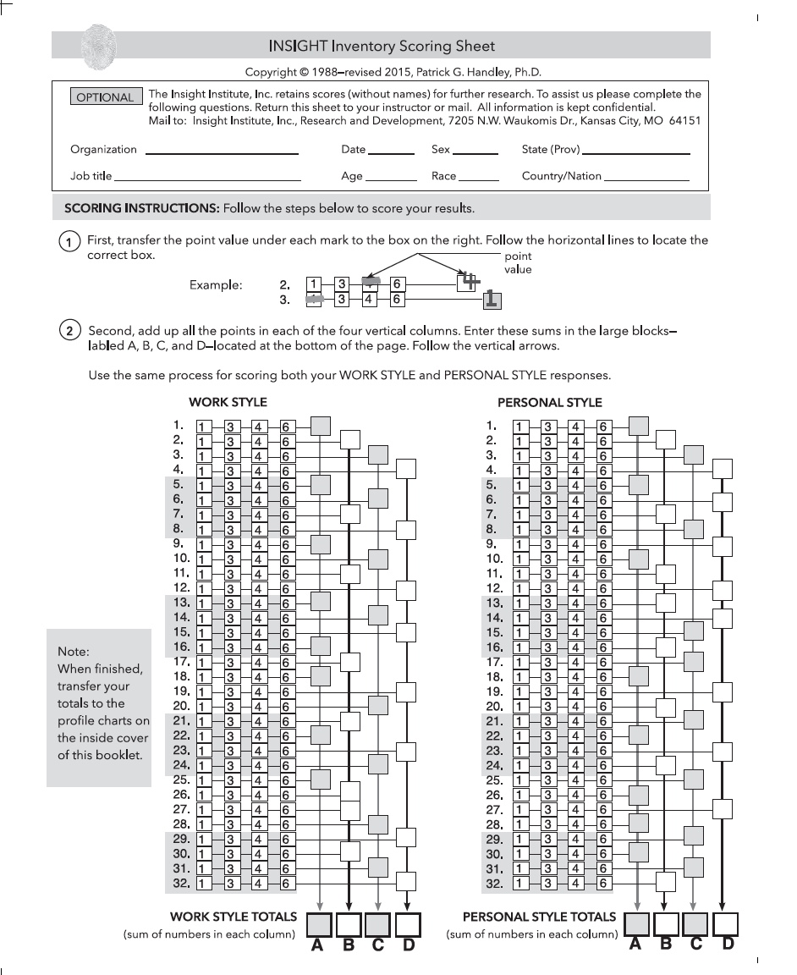
2nd
Score your results

Slide 9
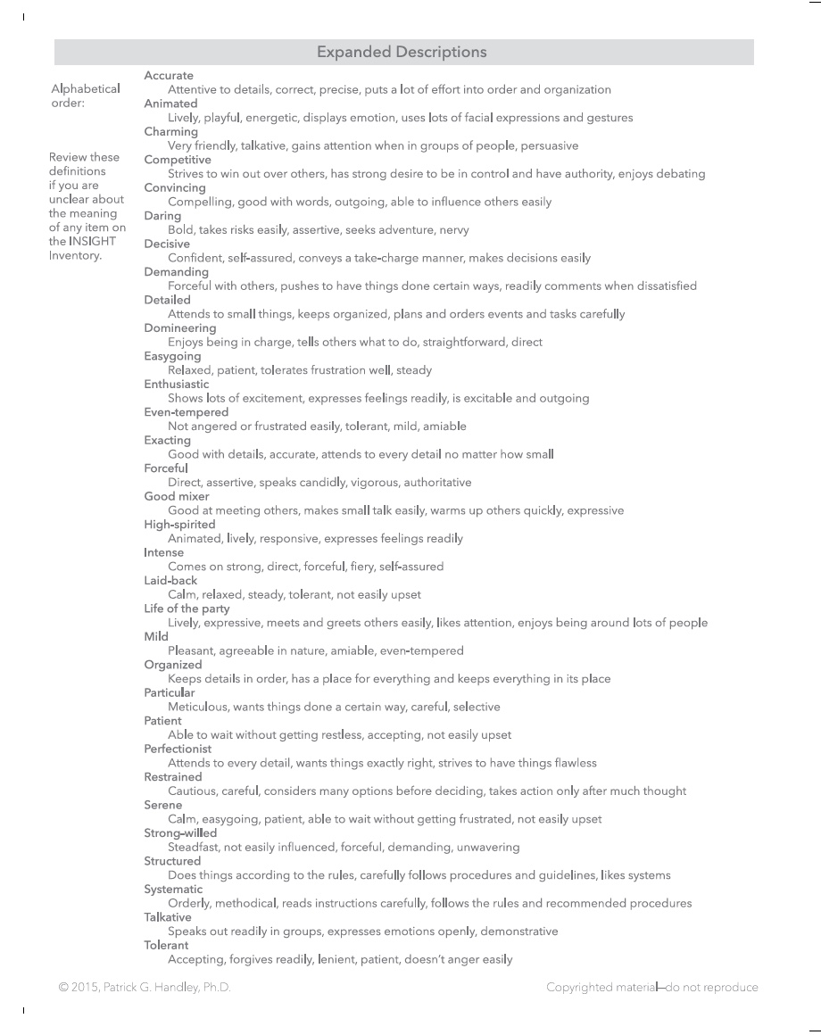
If helpful, refer to the
expanded descriptions on the back of the carbonless scoring sheet.

Slide 10
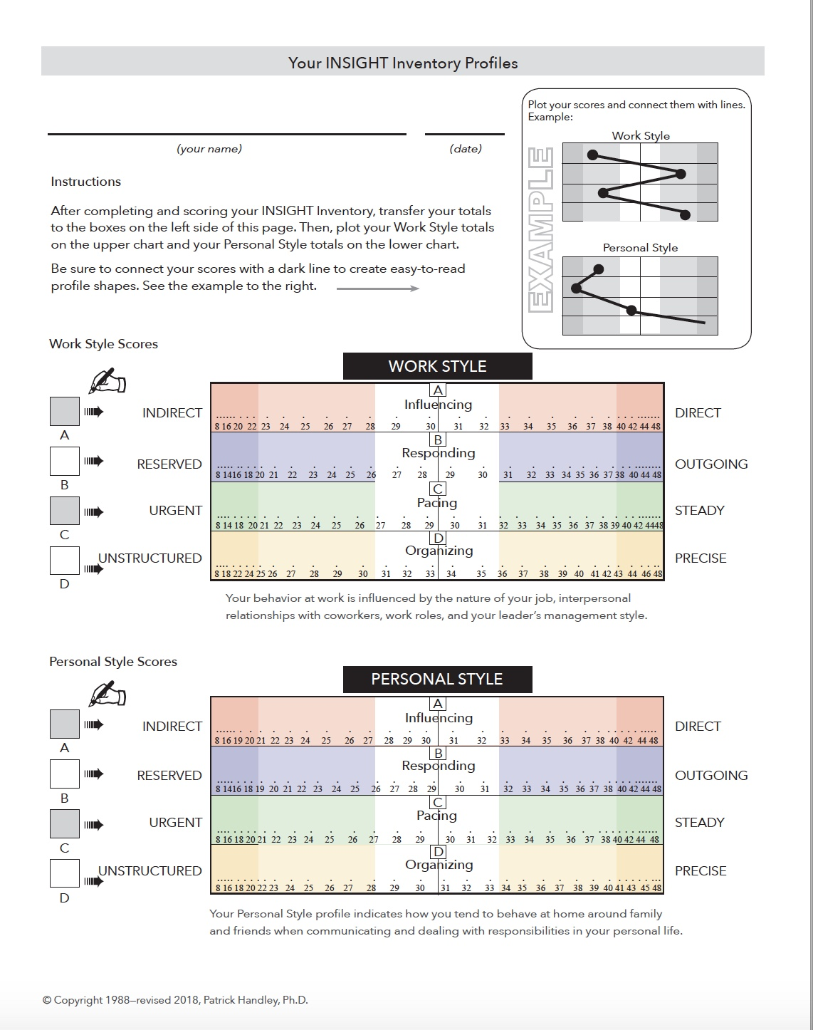
3rd
Plot your profiles.

Slide 11
Tip
John Doe
Use big dots and thick lines so your profiles are easy to see and share with others.

Slide 12
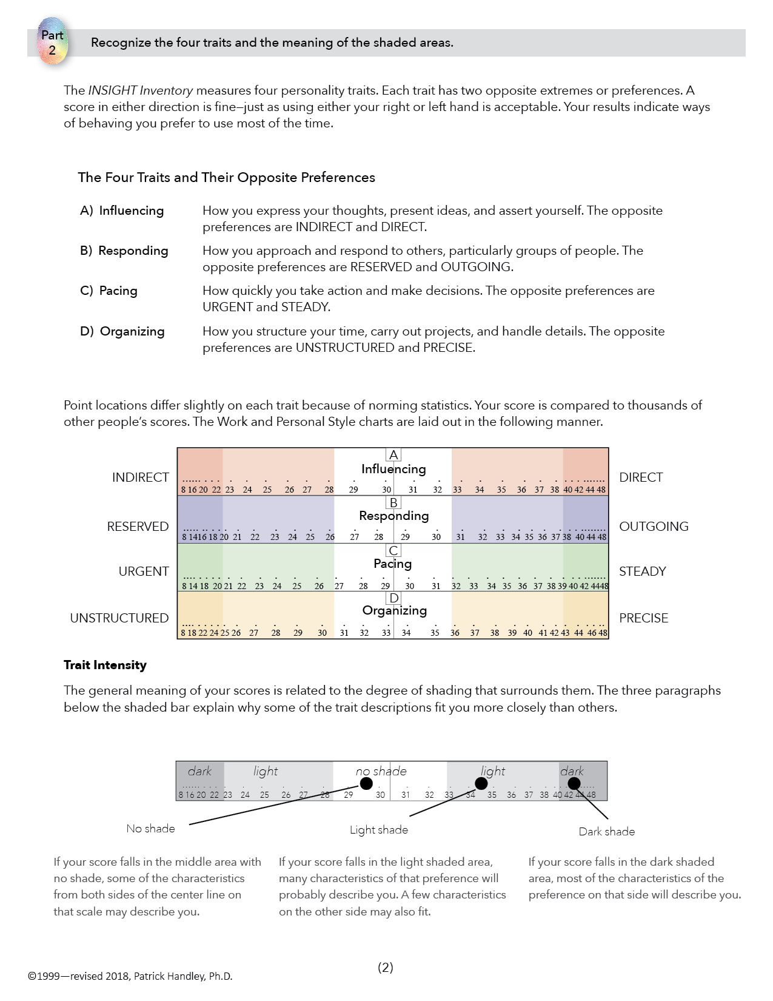
PART
2
Recognize the four traits and the meaning of the shaded areas.

Slide 13
THE FOUR TRAITS
A: Influencing
Indirect Direct
B: Responding
Reserved Outgoing
C: Pacing
Urgent Steady
D: Organizing
Unstructured Precise

Slide 14
PROFILE CHART

Slide 15
TRAIT INTENSITY
dark light no shade light dark
NO SHADE
Some characteristics from both sides may describe you.
LIGHT SHADE
Many characteristics of that preference will describe you—and one or two from the opposite side.
DARK SHADE
Most of the characteristics of that preference will describe you.

Slide 16
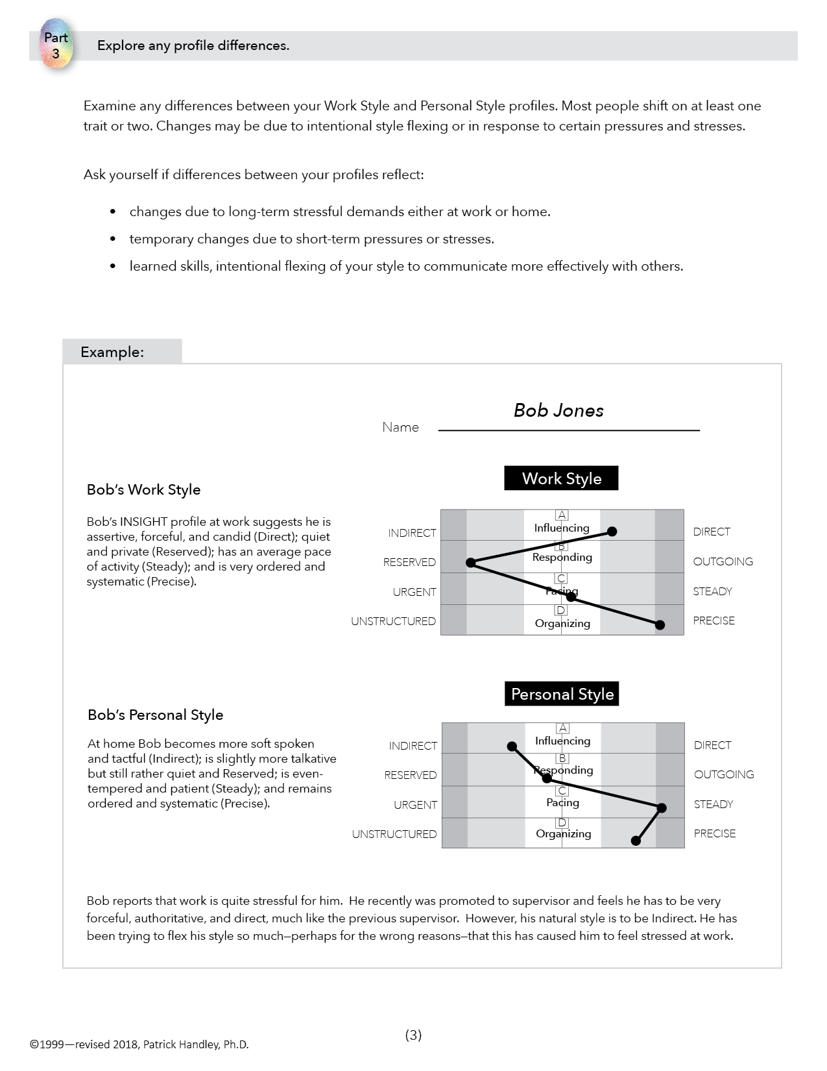
PART
3
Explore any profile differences.

Slide 17
PROFILE SHAPES
Personality style is a combination of all four traits and may be different in various settings

Slide 18
ENVIRONMENT
Every environment has:
• pressures & opportunities
• stresses & motivators
• inhibitors & encouragers

Slide 19
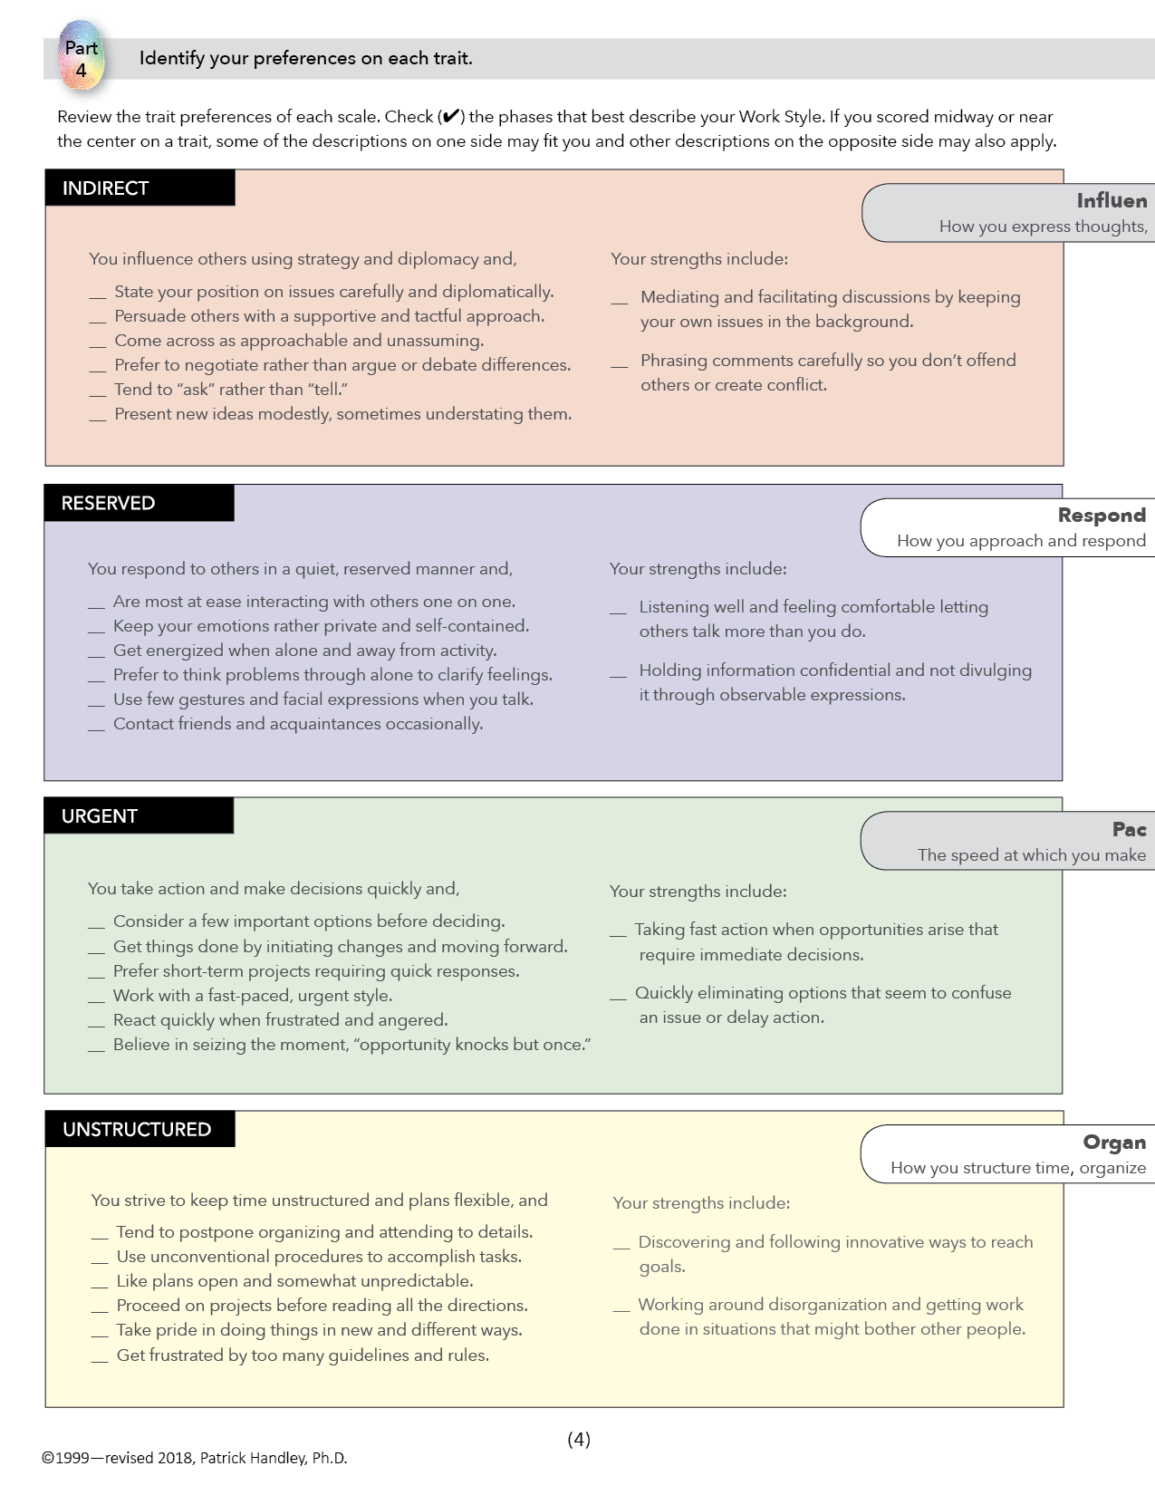
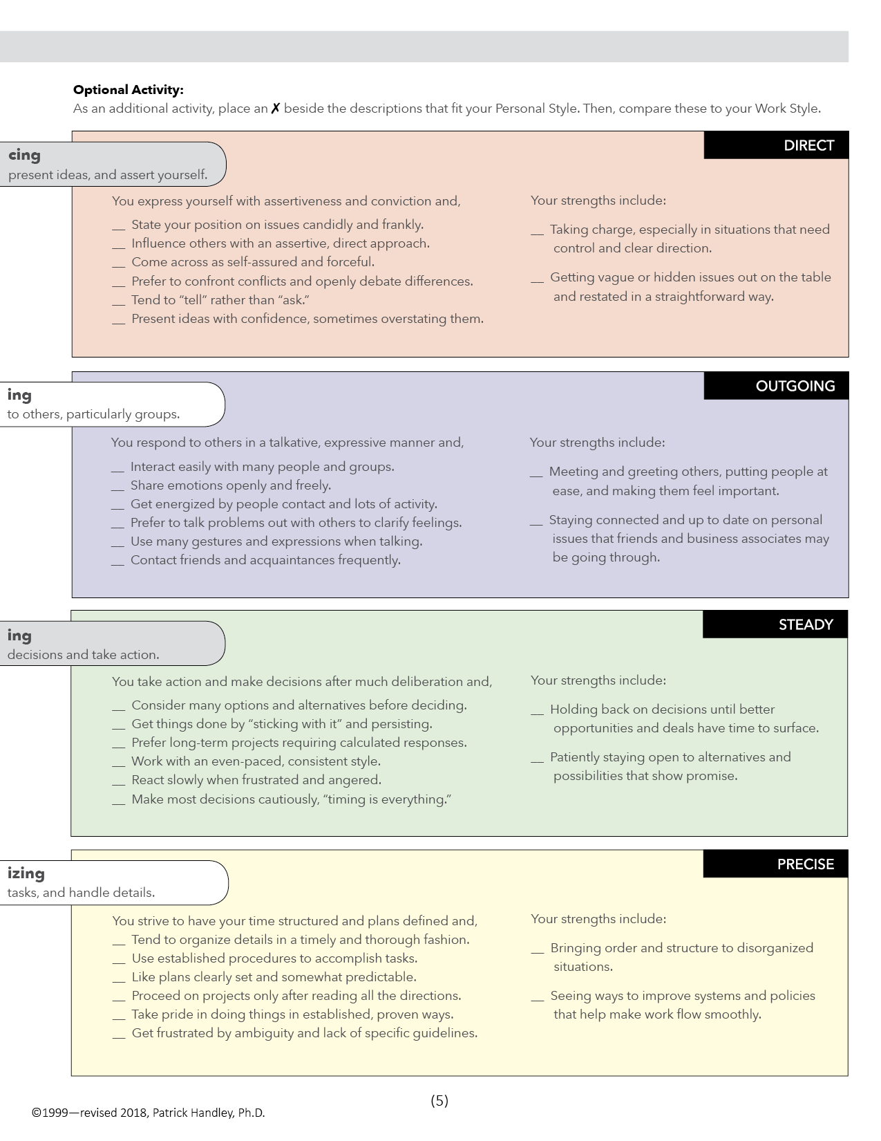
Identify your preferences on each trait.
PART
4

Slide 20
EXPLORING THE TRAITS
A: Influencing
B: Responding
C: Pacing
D: Organizing

Slide 21
SCALE A
Influencing
How you express thoughts, present ideas
and assert yourself.
INDIRECT
DIRECT

Slide 22
INDIRECT
DIRECT
• Diplomatic
• Tactful
• Approachable, unassuming
• Prefer to negotiate
• “Ask” versus “Tell”
• Modest
• Straightforward
• Frank
• Forceful, self-assured
• Will debate issues
• “Tell” versus “Ask”
• Confident

Slide 23
STRENGTHS
INDIRECT
DIRECT
Good mediator
Careful at restating comments
Good at taking charge
Gets issues out in open

Slide 24
SCALE B
Responding
How you approach and respond to others, particularly groups.
RESERVED
OUTGOING

Slide 25
RESERVED
OUTGOING
Quiet
Enjoy one-to-one
Private, self-contained
Prefer to think problems out alone
Few gestures
Talkative
Enjoy groups
Open, expressive
Prefer to talk problems out
Lots of gestures

Slide 26
STRENGTHS
RESERVED
OUTGOING
Good listener
Keeps information confidential
Good at meeting/greeting
Stays connected with others

Slide 27
SCALE C
Pacing
The speed at which you make decisions and take action
URGENT
STEADY

Slide 28
URGENT
STEADY
Decide quickly
Change readily
Consider a few key options and then decide
Prefer short-term projects
Deliberate
Change hesitantly
Consider many options and then decide
Do well with long, extended projects

Slide 29
STRENGTHS
URGENT
STEADY
Good at moving ahead
Seldom misses opportunities
Good at thinking things through
Resists impulses

Slide 30
SCALE D
Organizing
How you structure time, organize tasks,
and handle details.
UNSTRUCTURED
PRECISE

Slide 31
UNSTRUCTURED
PRECISE
Seek flexibility
Postpone organizing
Unconventional
Frustrated by rules
Dislike planning
Seek order
Organize as a priority
Conventional
See benefit in rules
Like things well planned

Slide 32
STRENGTHS
UNSTRUCTURED
PRECISE
Good at coping with change
Thinks outside the box
Good at organizing
Very effective planner

Slide 33
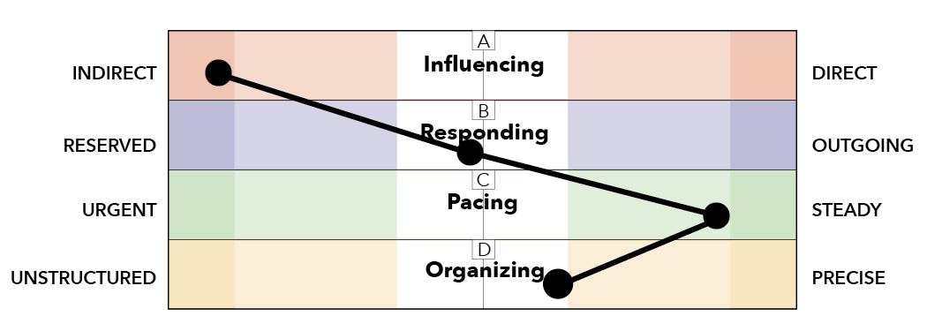
TRAIT INTENSITY
Others see your extreme traits, not the moderate ones.

Slide 34
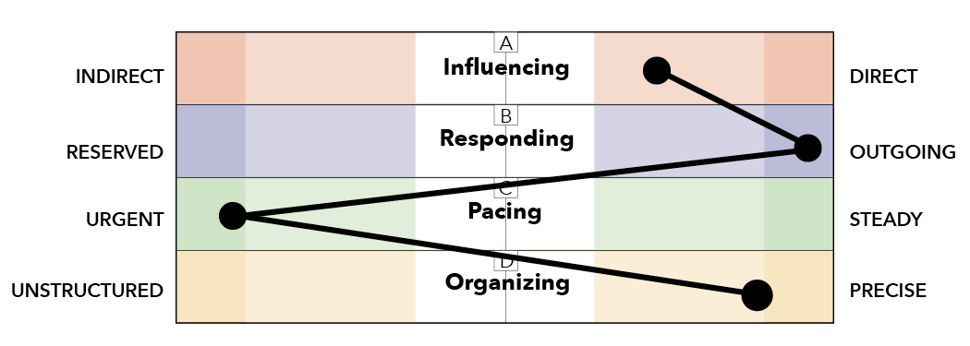
TRAITS vs. VALUES
Traits describe behaviors; values explain reasons.
spiritual minister
drug dealer
Note: same profile, different values

Slide 35
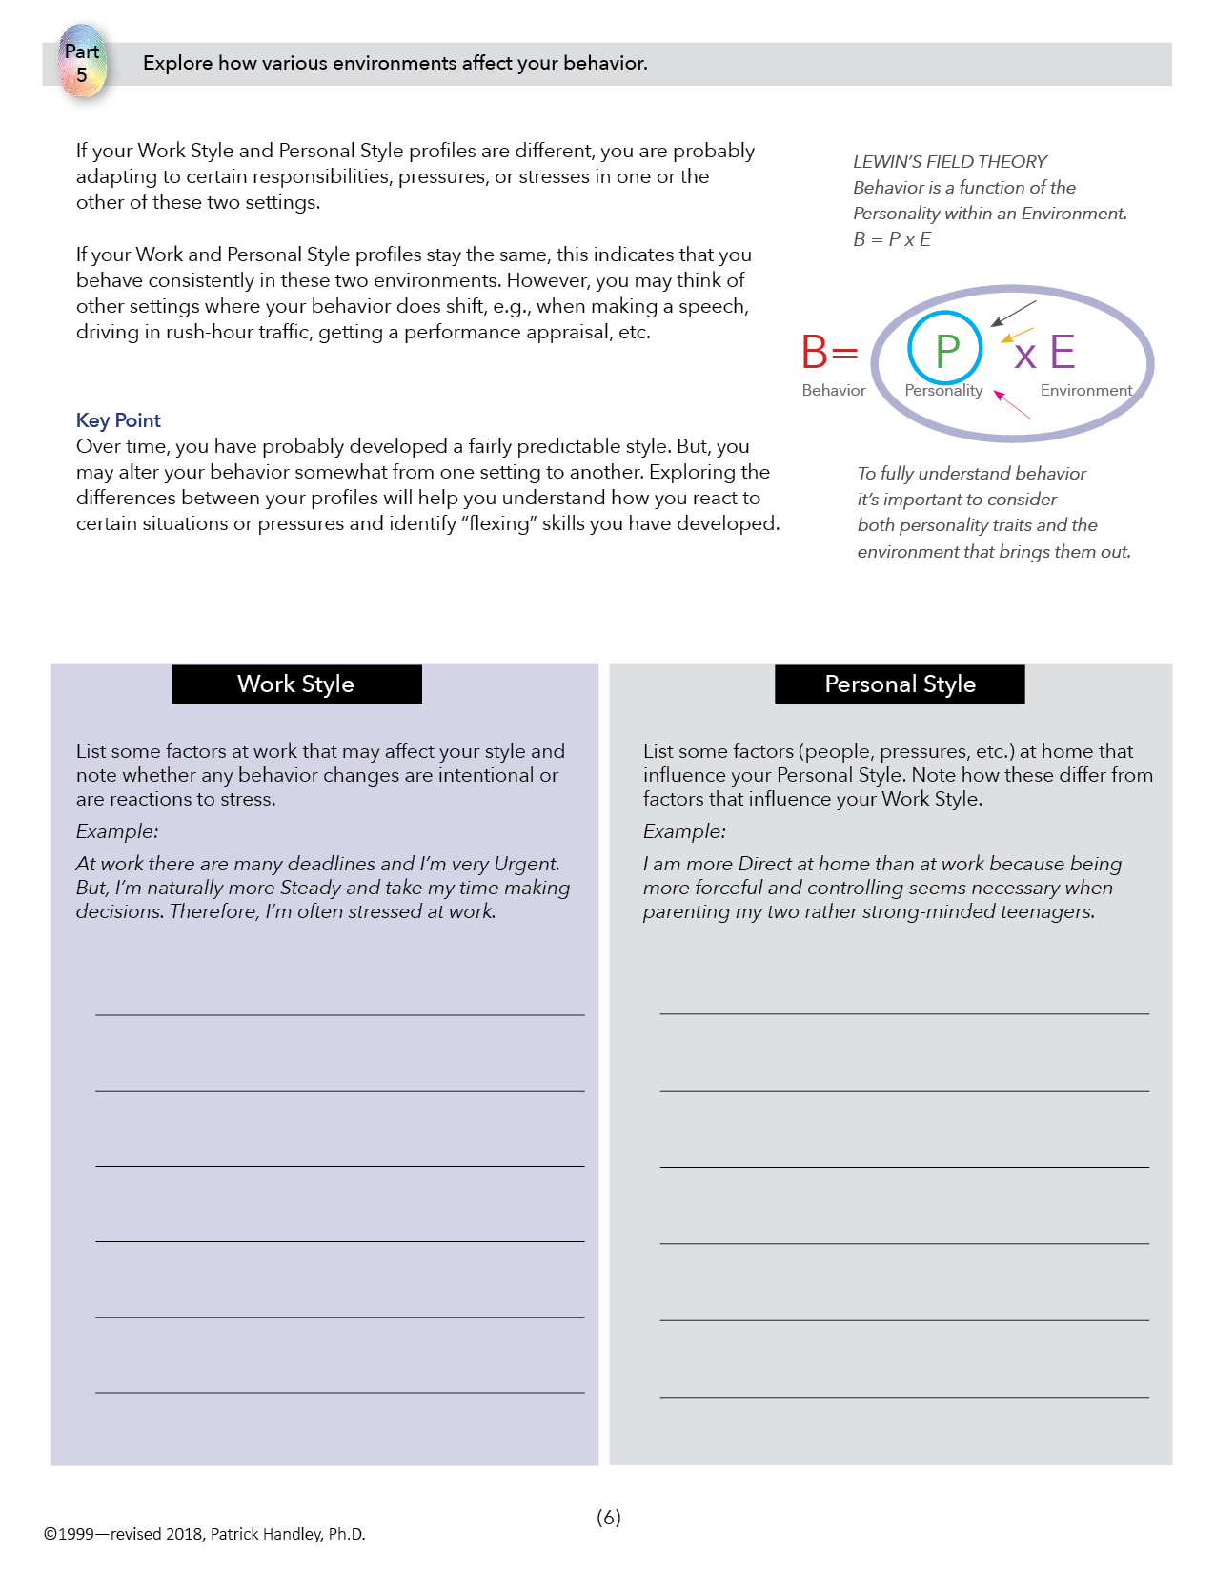
PART
5
Explore how various environments affect your behavior.

Slide 36
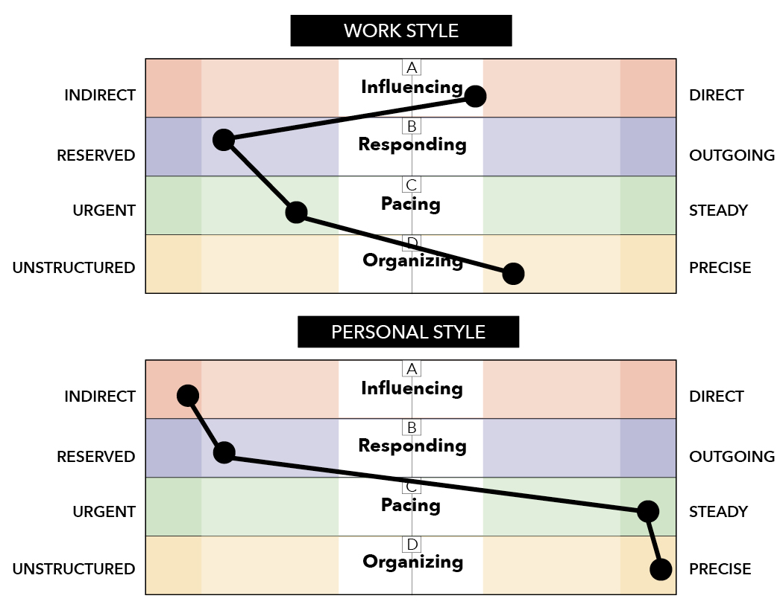
Changes between Environments
Behavior is a function of
Personality in an Environment.
B = f (P X E)
“You may behave differently in different settings.”

Slide 37
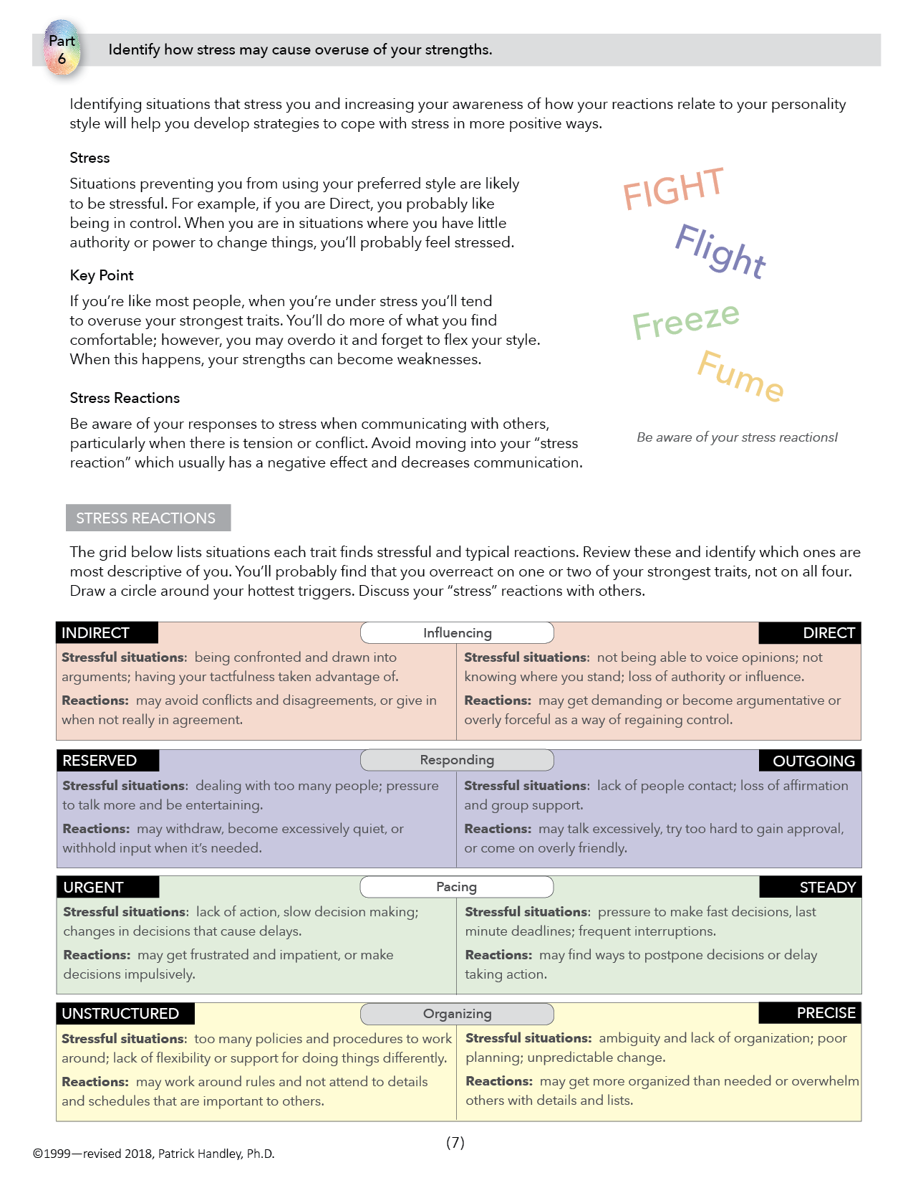
PART
6
Identify how stress may cause overuse of your strengths.

Slide 38
STRESS
Stress causes people to overuse
their strongest preferences!

Slide 39
STRESS REACTIONS
INDIRECT DIRECT
A
avoid, give in argue, push back
RESERVED OUTGOING
B
withdraw, don’t talk talk too much, oversell
URGENT STEADY
C
get impatient/impulsive delay too long, stall
UNSTRUCTURED PRECISE
D
drop details, bend rules rules, perfectionistic

Slide 40
Example 1:
How might these traits get “overused” when the person is under stress?

Slide 41
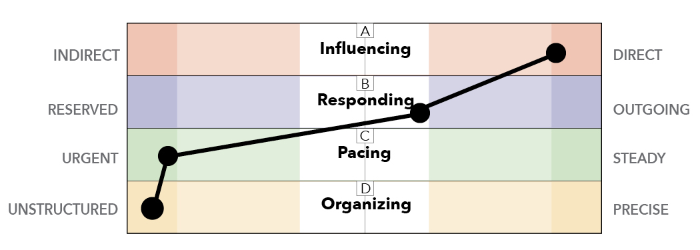
Example 2:
How might these traits get “overused” when the person is under stress?

Slide 42
Moving Out of Strengths
Examples:
A DIRECT person goes from candor and telling
to yelling and demanding
An URGENT person goes from fast action
to impatience and irritation

Slide 43
TRIGGERS and HOT BUTTONS
Triggers are behaviors, gestures, or comments that trigger an extreme reaction in you and cause you to INSTANTLY shift away from your strengths.

Slide 44
Examples of Triggers
silent
treatment
loud voice
rolling eyes
staring glaring
finger pointing
no eye contact
walking away
smirking

Slide 45
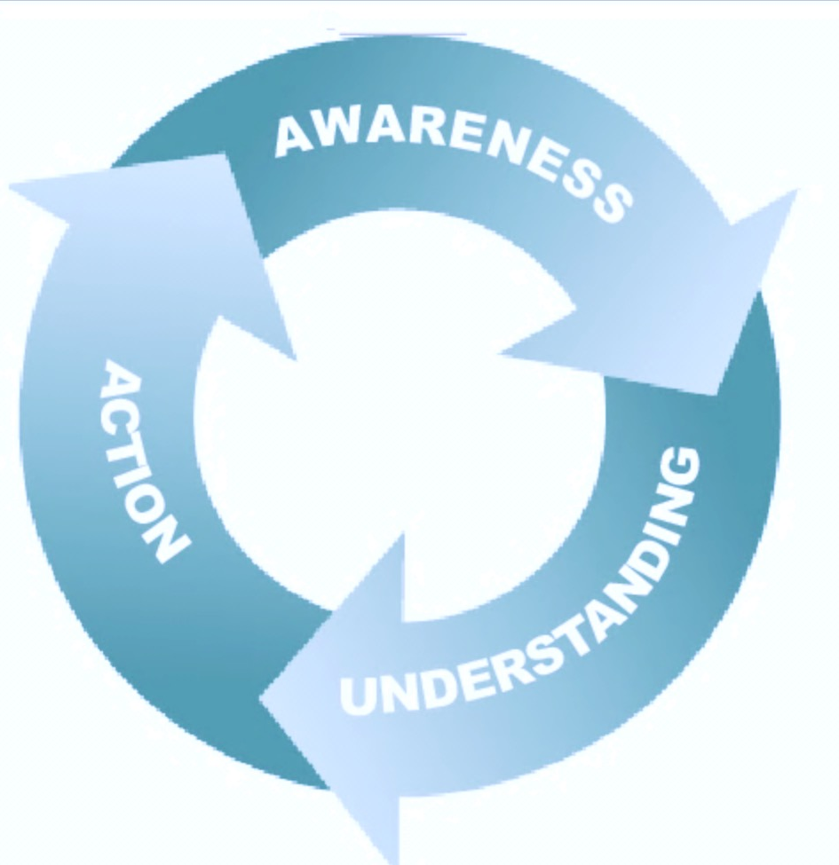
CHANGE CYCLE
1) AWARENESS
spot your triggers
2) UNDERSTANDING
identify the source
3) ACTION
create a new thought pattern

Slide 46
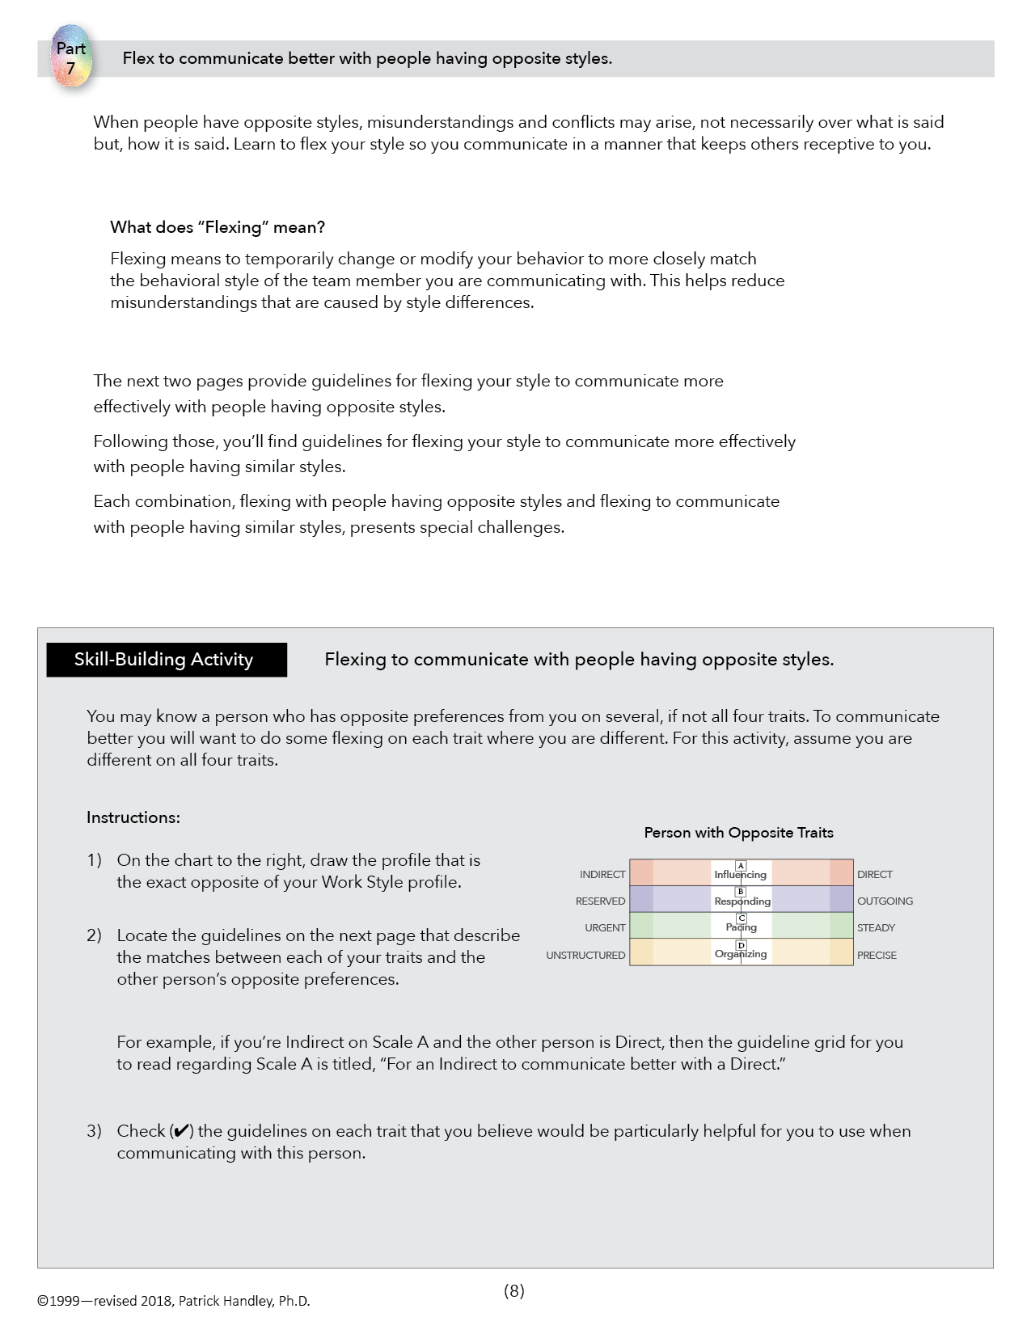
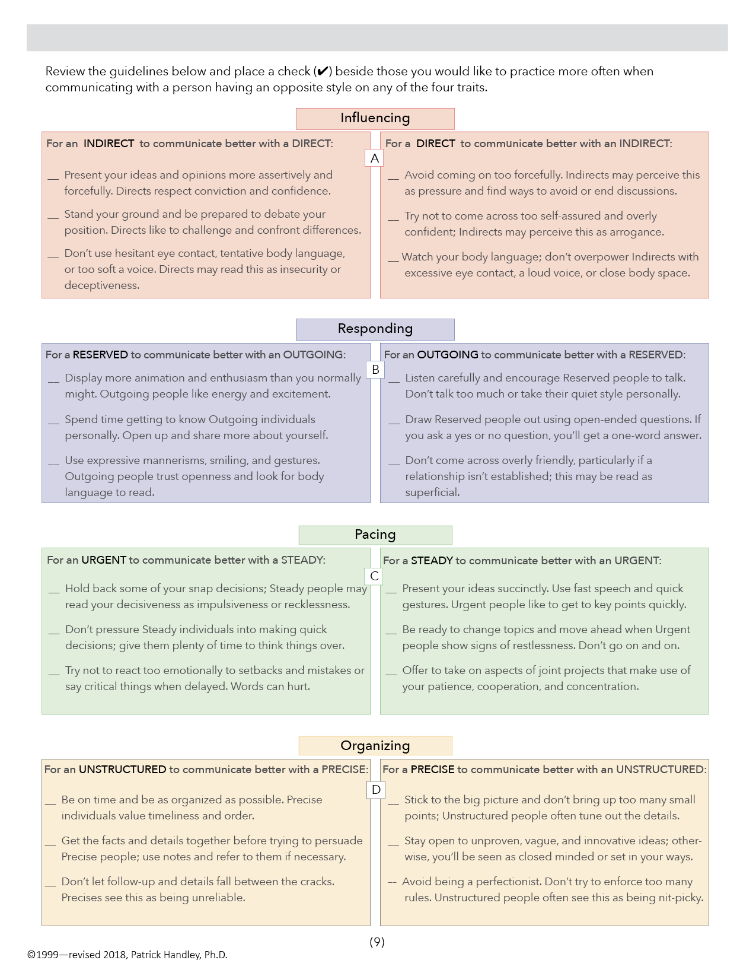
Flex to communicate better with people having opposite styles.
PART
7

Slide 47
FLEXING
The goal is to temporarily change your style to communicate differently with various people.
Then, move back to your preferred style.

Slide 48
Flexing Opposite Styles
Misunderstandings and conflicts arise not over what is said, but how it is said.
Flex to communicate with others in the manner they are most receptive to.

Slide 49
Opposite traits may complement. (1+1>2)
Opposite traits may conflict. (1+1<1)
Person A
Person B

Slide 50
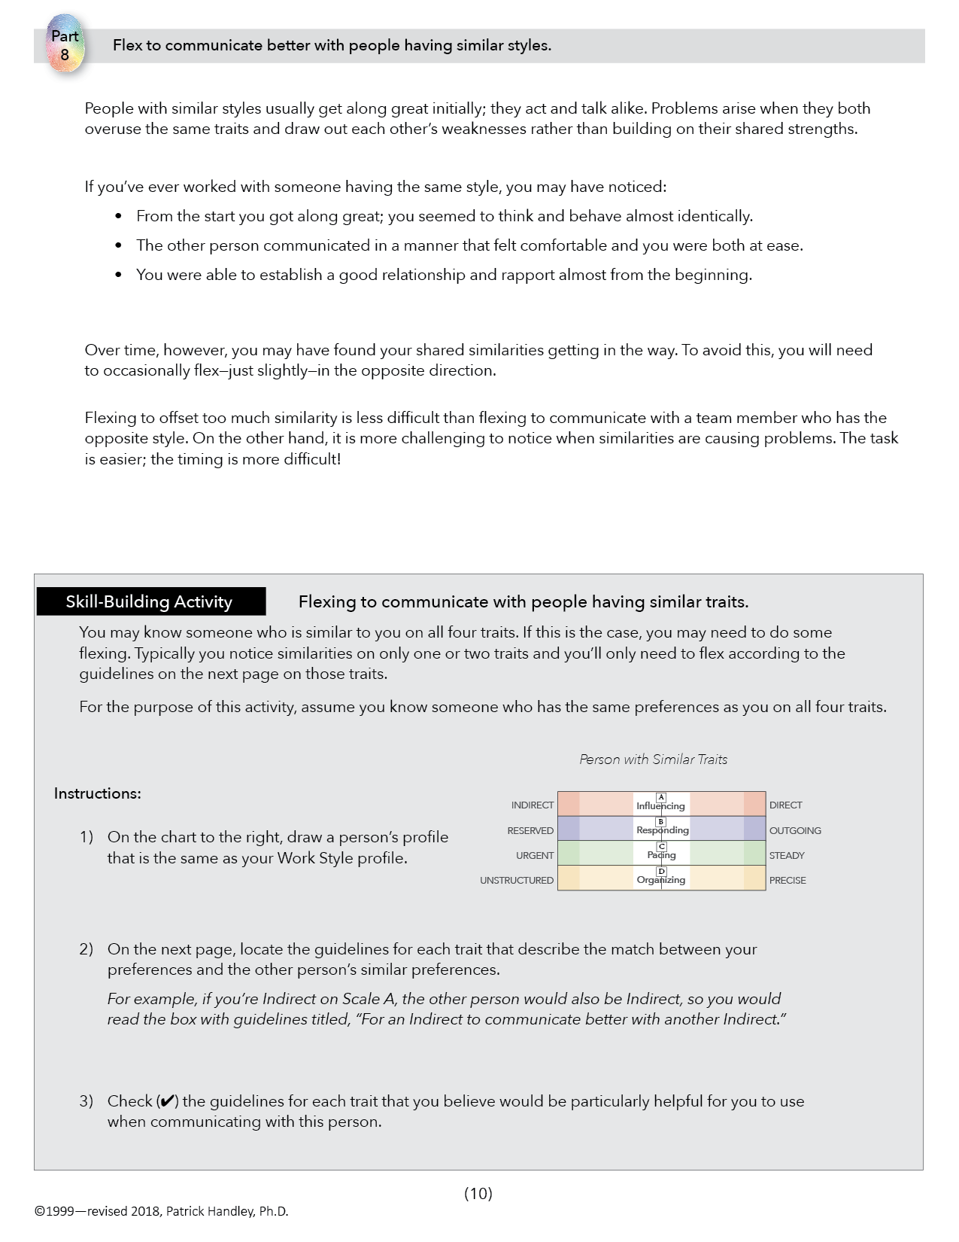
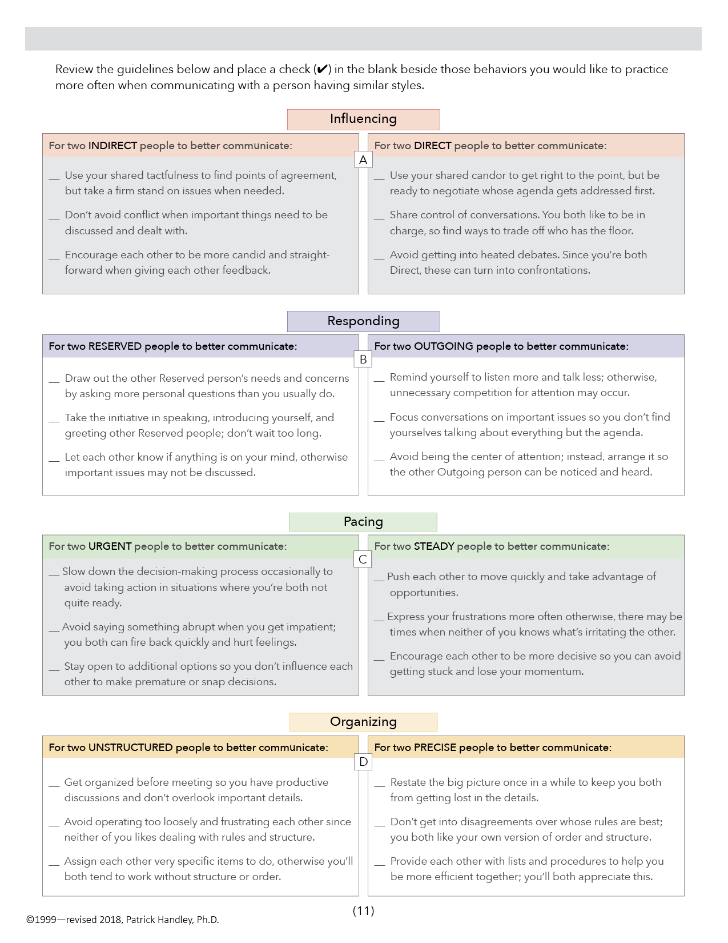
Flex to communicate better with people having similar styles.
PART
8

Slide 51
Flexing with Similar Styles
Similar styles usually get along great initially; they walk and talk alike.
Problems arise when they both overuse the same traits and draw out each other’s weaknesses.

Slide 52
Similar styles initially get along great.
Example 1: What problems might these two have?
Person C
Person D

Slide 53
Similar styles initially get along great.
Example 2: What problems might these two have?
Person E
Person F

Slide 54
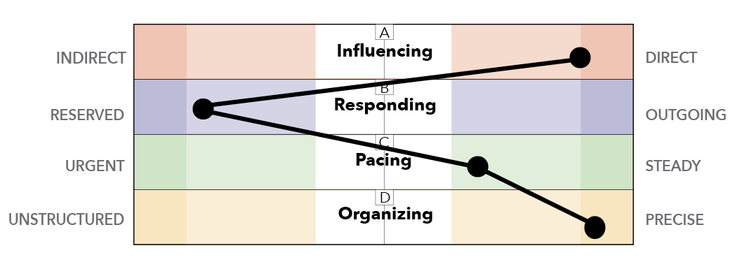
Communication Strategies
Example 1:
What strategies might work best with this person?

Slide 55
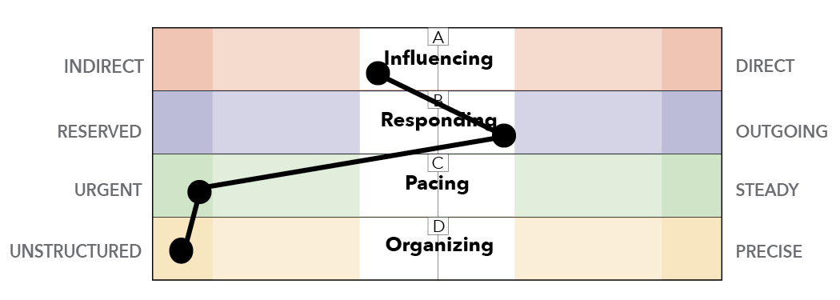
Communication Strategies
Example 2:
What strategies might work best with this person?

Slide 56
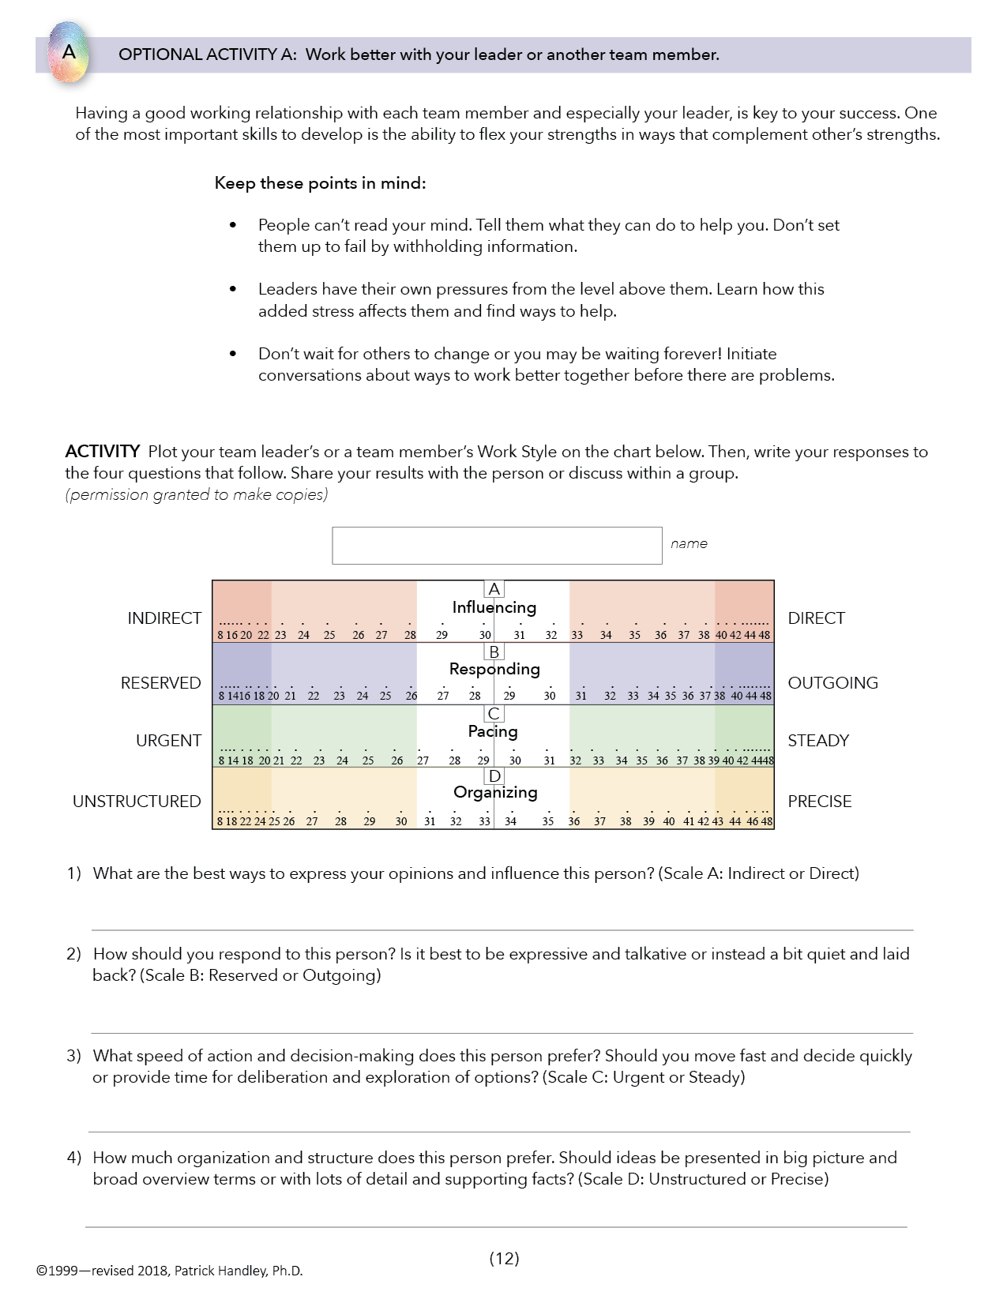
OPTIONAL ACTIVITY A
Work better with your leader or another team member.

Slide 57
Working better with your team leader.
Leaders can’t read your mind. Tell them what works best for you.
Leaders have their own pressures … don’t take them personally.
It’s up to you to learn to work with them.

Slide 58
Chart Your Leader’s or other Team Member’s Work Style.

Slide 59
Create a cluster chart on the leader.
•
•
•
•
•
•
•
•
•
•
•
•
•
•
•
•
•
•
•
•
Each member may see the leader differently.
59

Slide 60
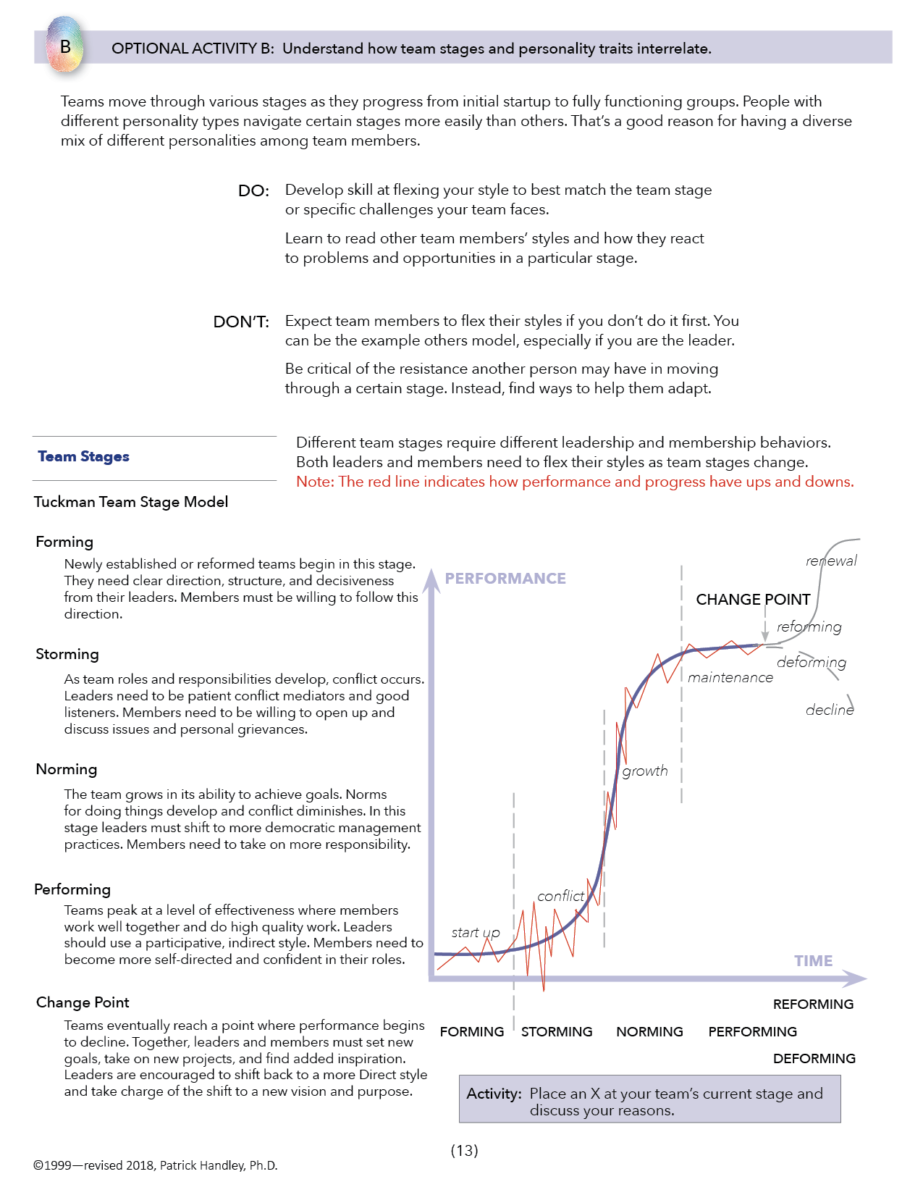
OPTIONAL ACTIVITY B
Understand how team stages and personality traits interrelate.

Slide 61
Team Stages
performance
PERFORMING
NORMING
STORMING
FORMING
time

Slide 62
Part 10
Team Stages
performance
PERFORMING
NORMING
STORMING
FORMING
time

Slide 63
Team Stages
change point
reforming
deforming
63
63

Slide 64
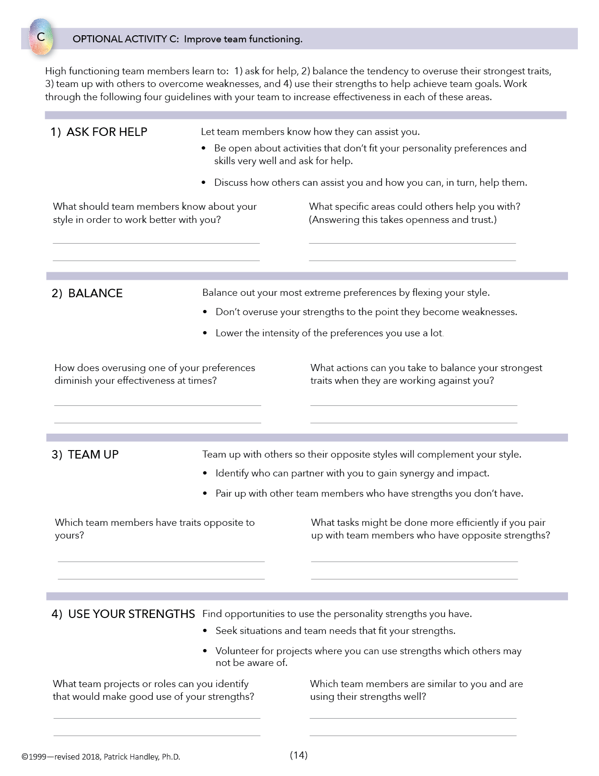
OPTIONAL ACTIVITY C
Understand how team stages and personality traits interrelate.

Slide 65
ASK FOR HELP
Let team members know how they can assist you.
Be open about activities that don’t fit
Discuss how they can help you and you them
What should others know about you?
What specific areas could others help you with?
65

Slide 66
2) BALANCE
Balance your most extreme preferences.
Don’t overuse your strengths
Lower the intensity
How does overusing strengths diminish your effectiveness?
What actions can you take to balance strengths?
66
66

Slide 67
3) TEAM UP
Team up with opposite styles.
Identify partners that create synergy and impact
Pair up for strengths you don’t have
Which team members have opposite strengths?
What tasks could be done more efficiently in team pairs?
67
67

Slide 68
4) USE YOUR STRENGTHS
Find opportunities to use strengths.
Seek best fitting situations and needs
Volunteer for projects that challenge your strengths
What projects make good use of strengths?
Which members have similar strengths and are using them?

Slide 69
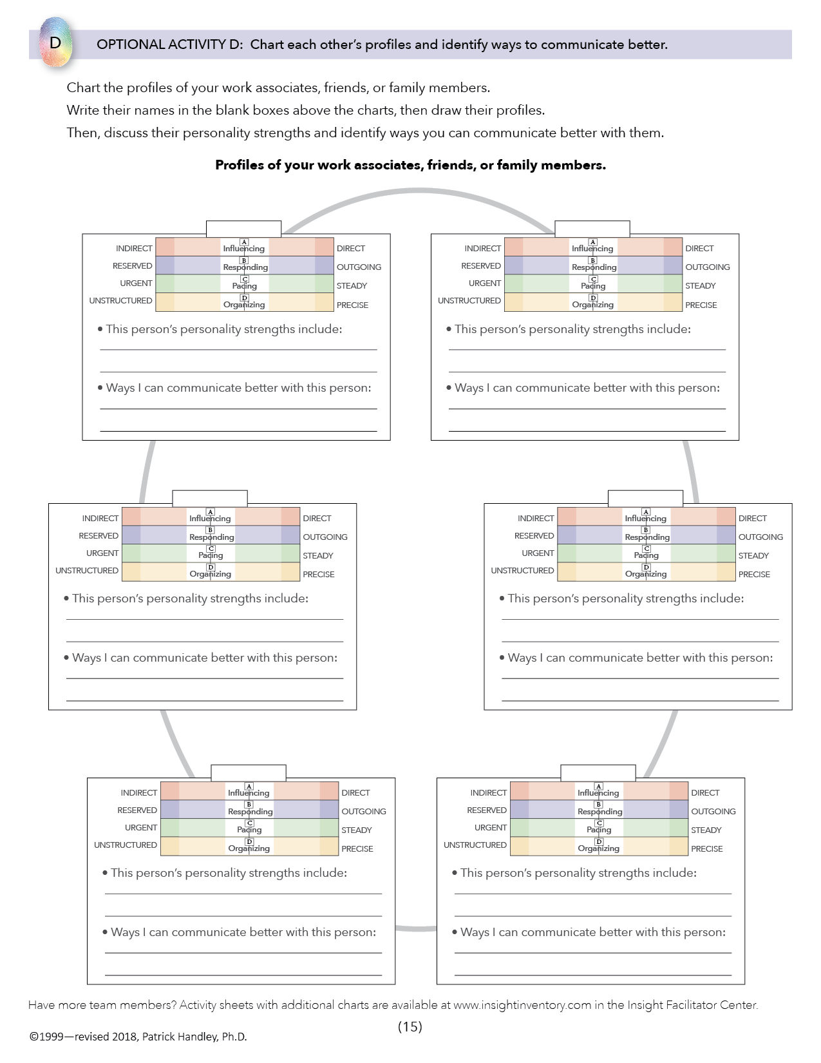
OPTIONAL ACTIVITY D
Chart each other’s profiles and identify ways to communicate better.

Slide 70
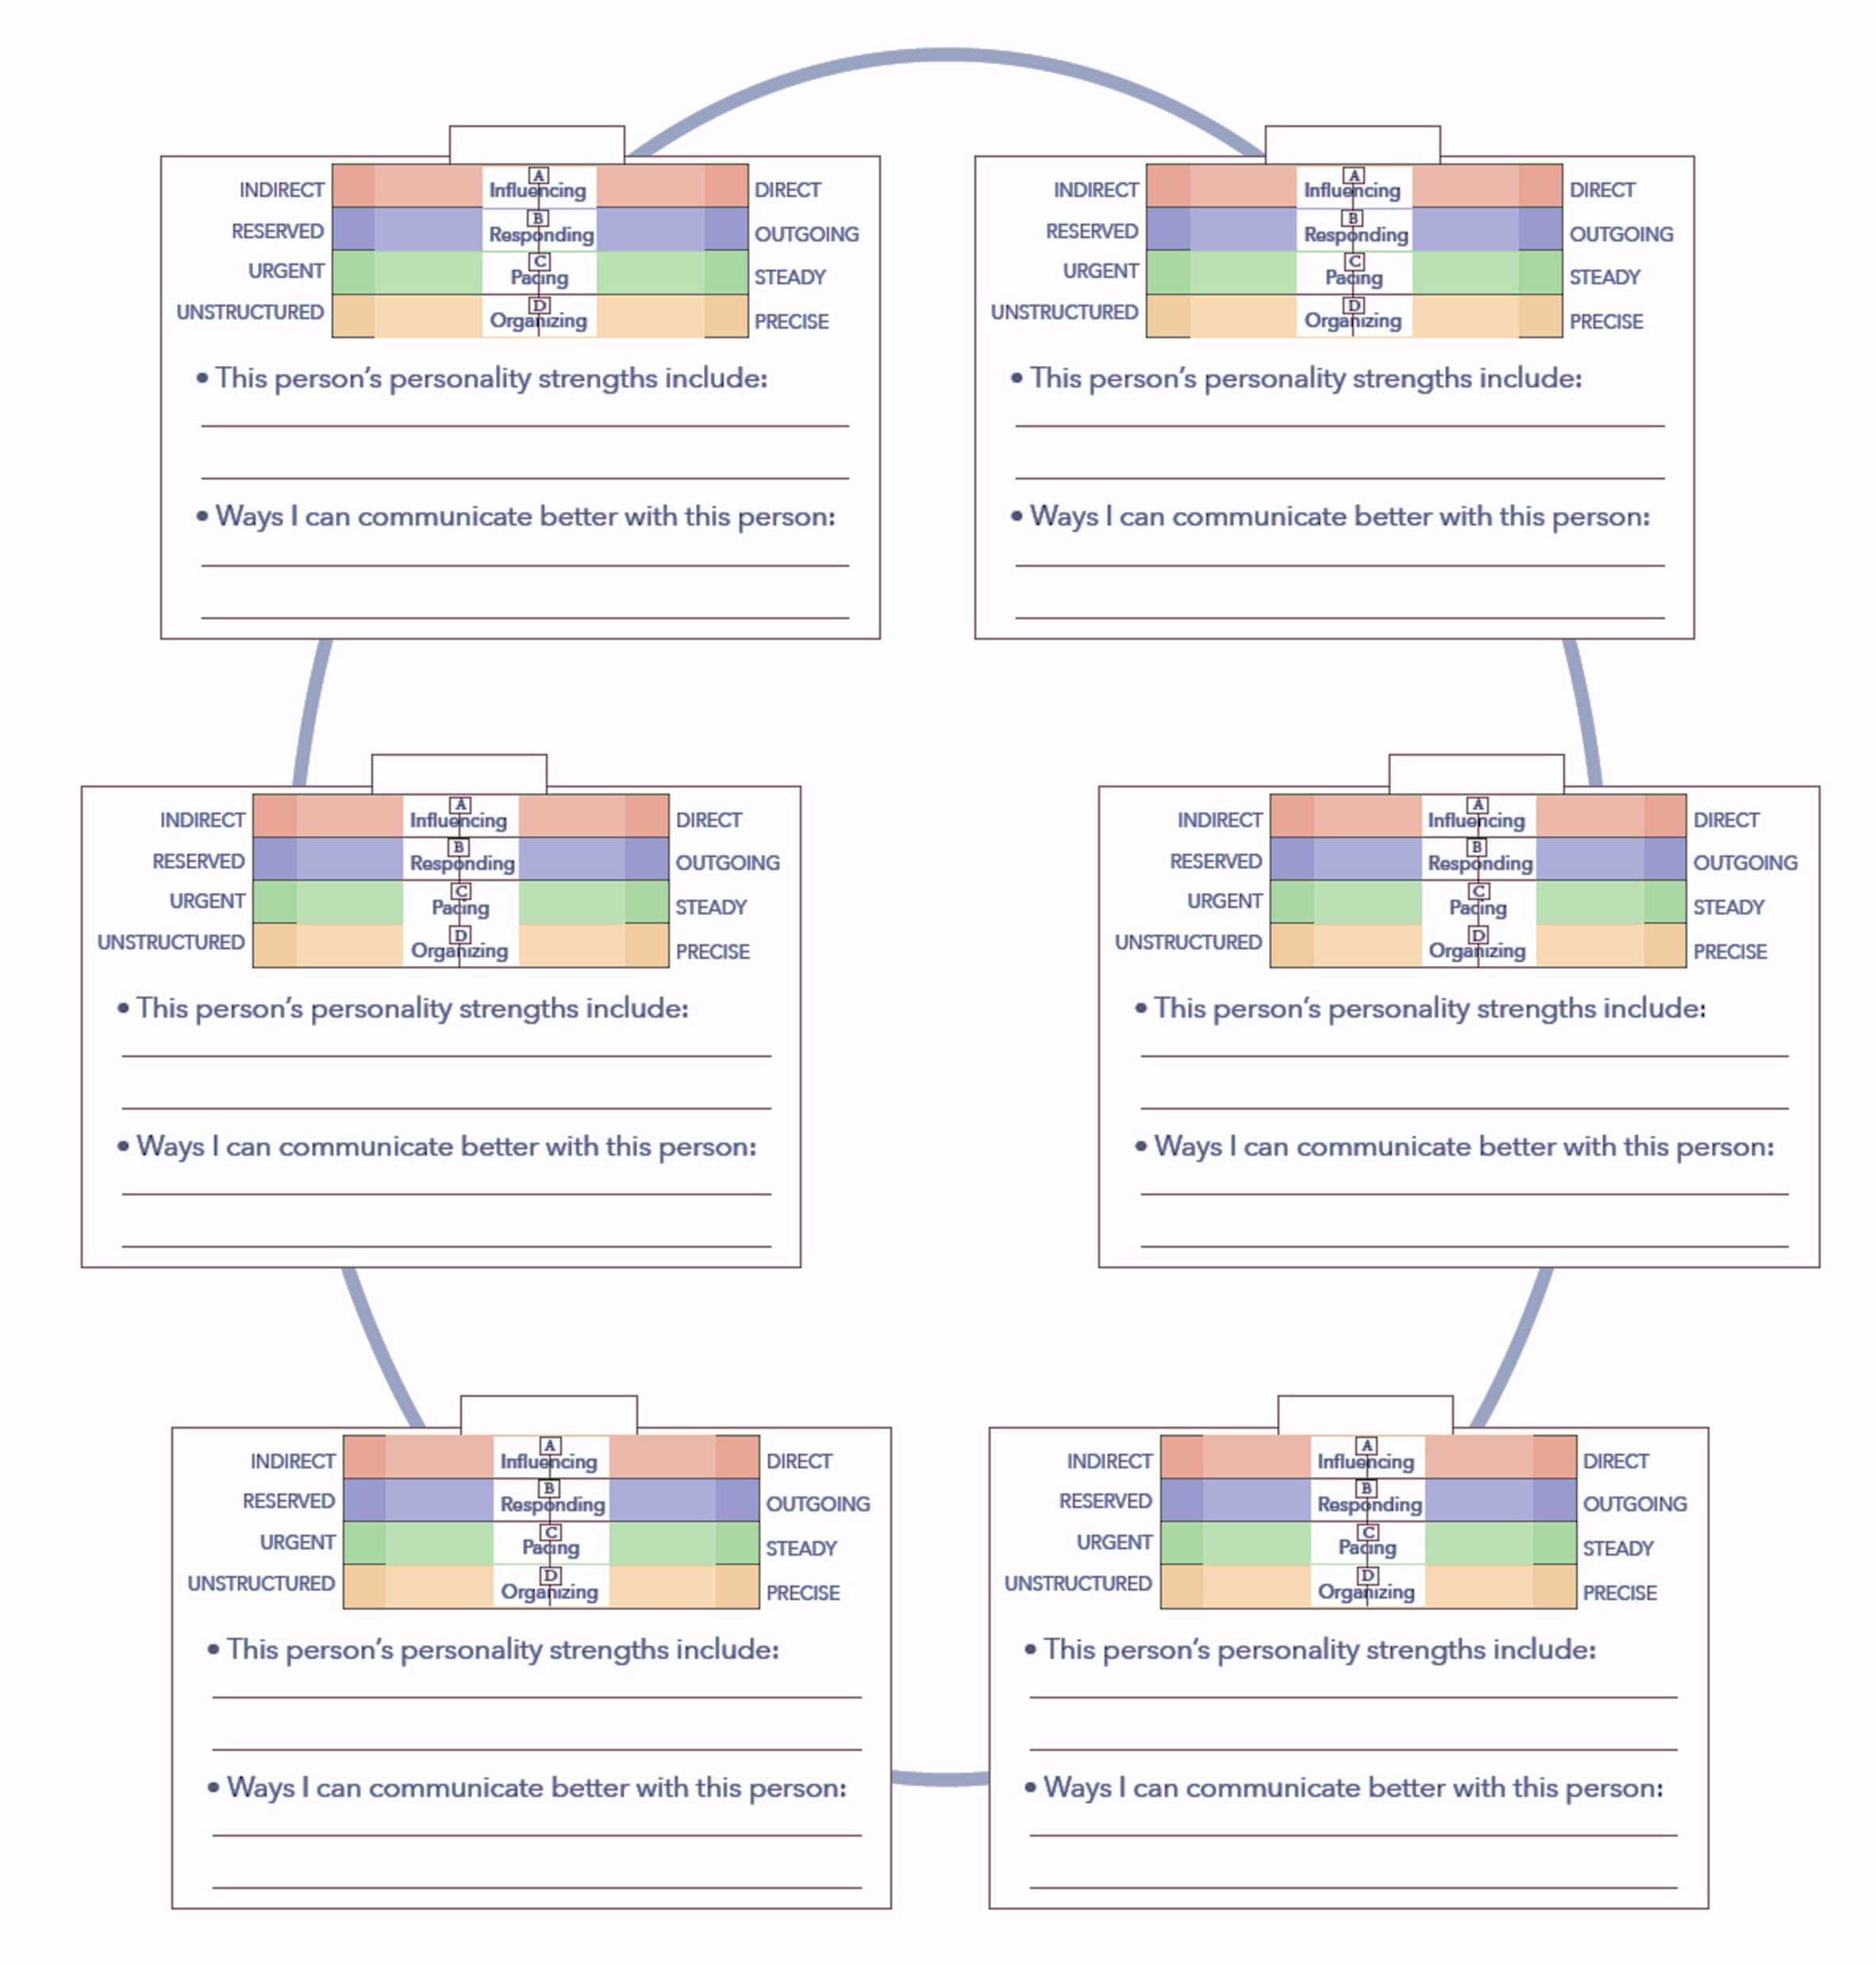
Plot the profiles of team members.
Discuss:
Each person’s strengths
Ways to communicate better

Slide 71
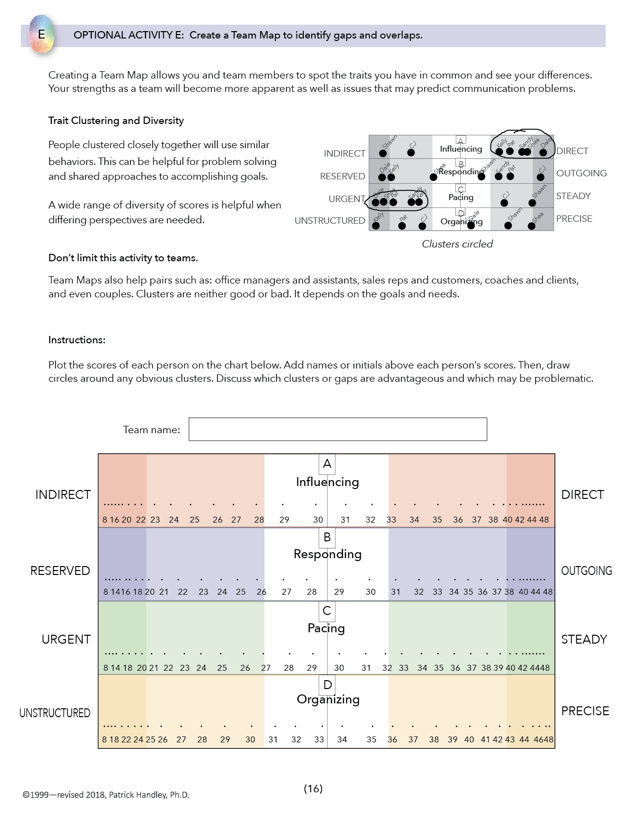
OPTIONAL ACTIVITY E
Create a Team Map to identify gaps
and overlaps.

Slide 72
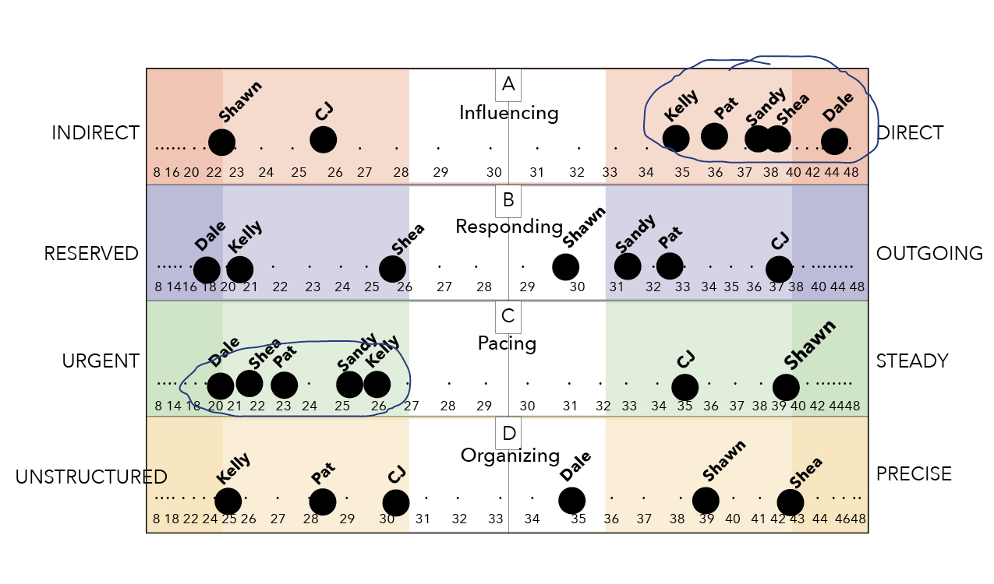
Create a TEAM CLUSTER MAP

Slide 73
Action Plan
Identify key “insights” you gained.
List actions you plan to take to improve communication and teamwork.

Slide 74
End

